Slide 1

UEFI
Unified Extensible Firmware Interface

Slide 2
What is UEFI?
The Unified Extensible Firmware Interface, also known as UEFI (pronounced “oofy” or “U effy”) was originally developed by Intel. UEFI is a specification that defines a software interface between an operating system and platform firmware. UEFI replaces the Basic Input/Output System (BIOS) firmware interface originally present in all standard firmware interface for PCs.

Slide 3
Why UEFI?
UEFI is the replacement for BIOS
The BIOS (basic input/output system) has been at the heart of the PC design for well over 30 years now. It is the piece of firmware that provides the operating system with a standard interface to the functionality of the computer. Unfortunately, its design is quite outdated, carrying a number of limitations that are not acceptable in the current age of computing. UEFI is brings with it a host of modern functionality to carry PCs through the next few decades. It's designed to improve software interoperability and address limitations of BIOS.

Slide 4
A Quick History of UEFI
There was a need to address limited storage and pre-boot manageability with traditional BIOS. Back in 1998, Intel initiated the “Intel Boot Initiative” (IBI) for their enterprise-class Intel IA-32 and -64 processors for overcome this issue. Later rebranded the initiative to EFI. Later Intel handed over the entire EFI initiative and all its specifications to the newly founded UEFI forum, which is consists of some of the leaders of our industry: AMD, American Megatrends Inc, Apple, Dell, HP, IBM, Intel, Lenovo, Microsoft, and Phoenix Technologies and 170 members and growing.. The UEFI was born and forum members are responsible for keeping the UEFI specifications up to date.

Slide 5
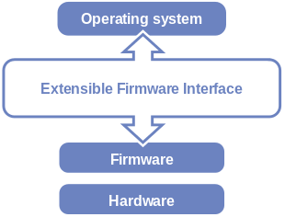

Unified Extensible Firmware Interface
EFI's position in the software stack
UEFI logo

Slide 6
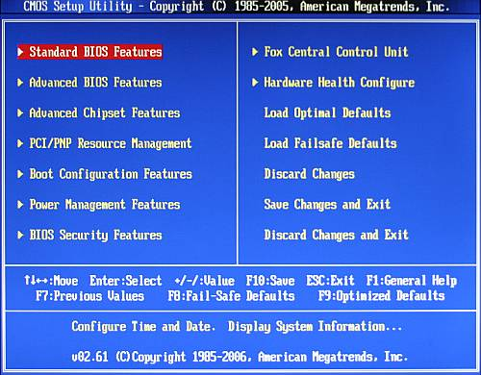
What’s Wrong with BIOS ?
Servicing a fleet of company desktop PCs or laptops that are in a non-bootable state (i.e. the OS is “broken”) is tough.
BIOS used in Intel 8088 processor which was 16-bit, and so the BIOS itself is 16-bit and is allowed 1MB of address space and has limited number of addressable devices. Your IT systems need to handle an increasing amount of devices. BIOS will fail you at some point it will simply deny handling the device or may even cause problems in an OS environment.

Slide 7
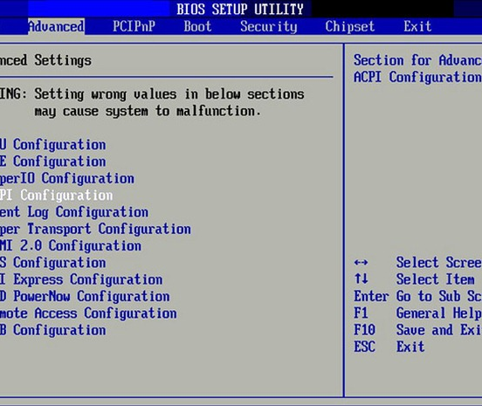
What’s Wrong with BIOS ?
Today’s vast number of USB ports, PCI devices, or built-in controllers (none of which existed 20-30 years ago), BIOS struggles with initializing them one-by-one. This struggle results in delays of up to 30 seconds before the actual operating system start its first boot sequence!
BIOS is physically unable to boot from hard disks with more than 2.1 TB. This problem lies within the old MBR system used by most BIOSes. The partition table is limited to 2.1 TB.
MBR also only supports up to four primary partitions.

Slide 8
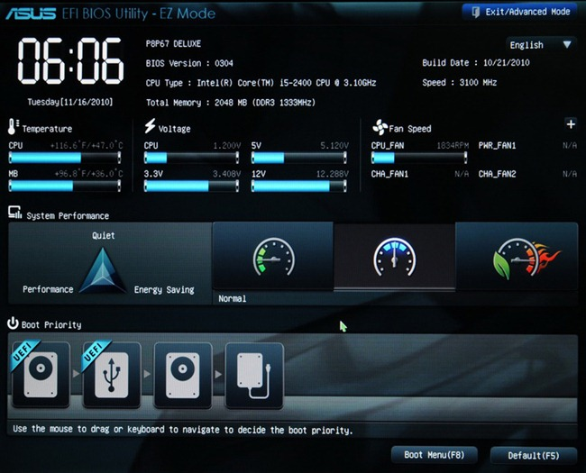
The Successor: UEFI
UEFI addresses all of the abovementioned issues in BIOS.
UEFI brought some major changes to the pre-boot environment.
Visuals
Many implementations of EFI just look like the traditional BIOS, but others customize the visual layout fundamentally. While pretty pictures aren’t really necessary, they can be really helpful for things like overclocking. Take a look at the differences: As you can see, it’s easy to use, mouse-capable, and has a lot of potential.

Slide 9
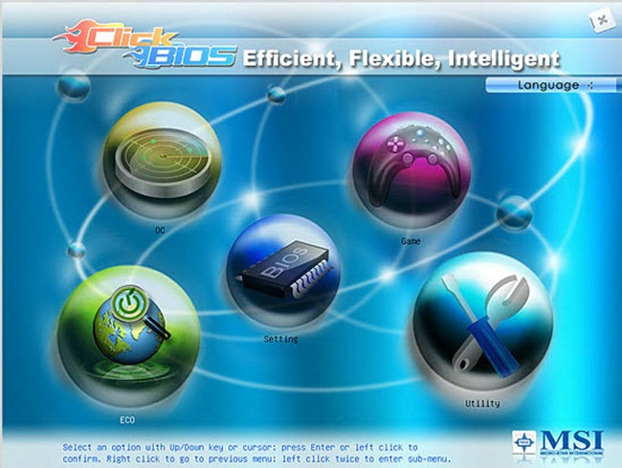
16-bit vs 32- and 64-bit
It can function in 32-bit and 64-bit modes, allowing much more RAM to be addressed by more complex processes. It also can be architecture independent and provide drivers for components that are also independent of what kind of CPU you have.
Booting
The MBR is limited to 4 primary partitions per disk and bootable disks are limited in size to 2.2 TB. UEFI uses the GUID Partition Table(GPT), which utilizes Globally Unique IDs to address partitions and allows booting from hard disks as large as 9.4 ZB. UEFI has excellent network booting abilities.

Slide 10
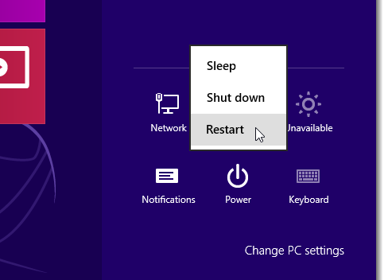
How to enter in BIOS configuration in UEFI enabled systems.
The days of pressing a function key or Esc to interrupt the boot process and get into the BIOS configuration (in UEFI enabled systems) are gone. There are three ways of accessing the new boot options menu in Windows 8 or 10 and we’ll show you how.
Simply find the Shut down / Restart menu and hold down the SHIFT key while clicking on Restart.
This even works if you haven’t logged into Windows at all, as long as you’re on the login screen and can access the restart menu.

Slide 11
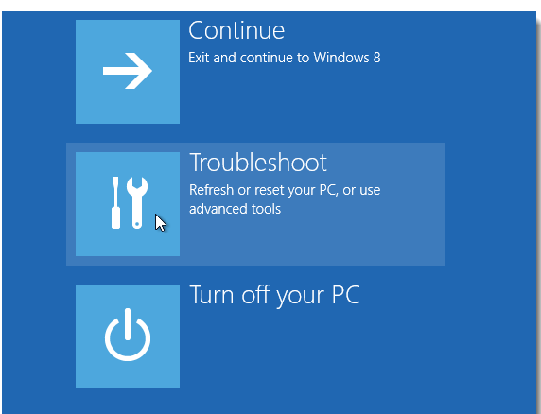
Once you’ve done this, instead of fully rebooting, the blue boot options menu displays. To access the options for refreshing or resetting your PC or to use the advanced tools, click Troubleshoot.

Slide 12
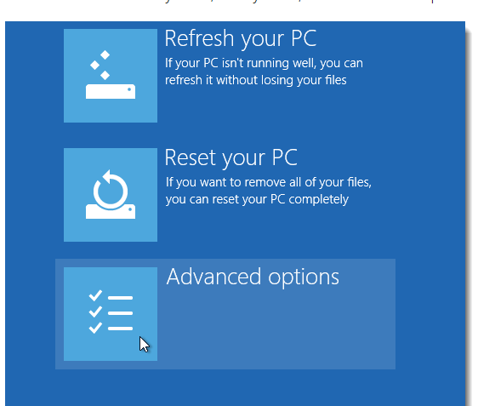
You can choose to Refresh your PC, Reset your PC, or access Advanced options.

Slide 13
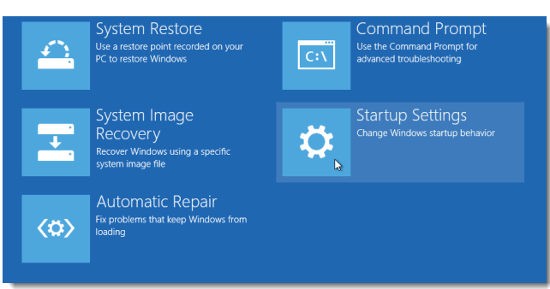
The options pictured are available on the Advanced options menu. To change how Windows starts up, such as booting into safe mode, click Startup Settings.

Slide 14
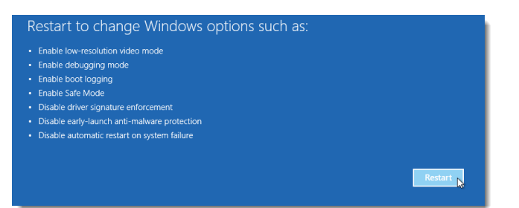
A list displays, showing you the options available when Windows restarts next time. Click Restart to restart Windows and gain access to these options.

Slide 15
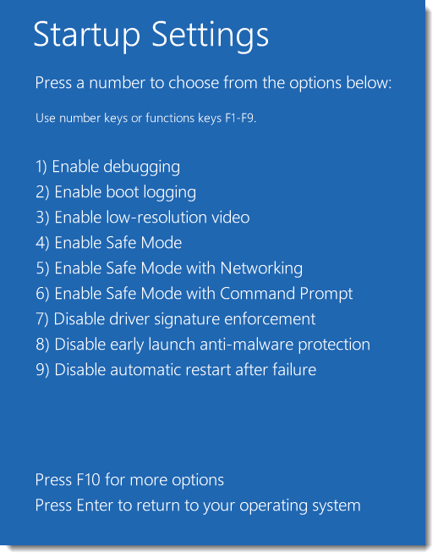
When your PC restarts, the Startup Settings menu displays. Select an option using the number keys or the function keys F1-F9. There is one additional option accessible by pressing F10.
If you decided you don’t want to use any of these options, you can boot normally by pressing Enter.

Slide 16
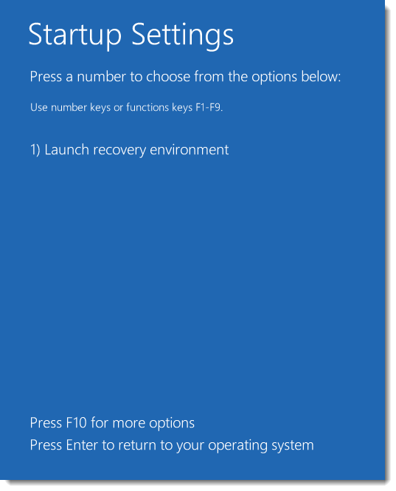
Launch recovery environment is the extra option accessed by pressing F10. To return to the other options, press F10 again.

Slide 17
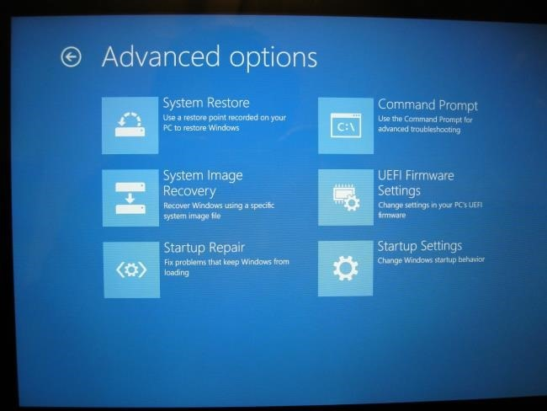
Access Low-Level UEFI Settings
To access the UEFI Firmware Settings, which are the closest thing available to the typical BIOS setup screen, click the Troubleshoot tile, select Advanced Options, and select UEFI Firmware Settings. Click the Restart option afterwards and your computer will reboot into its UEFI firmware settings screen.

Slide 18
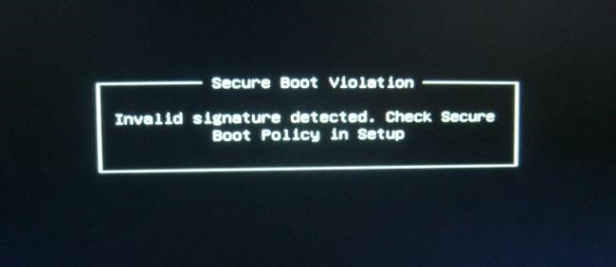
Secure Boot
The UEFI settings screen allows you to disable Secure Boot, a useful security feature that prevents malware from hijacking Windows or another installed operating system
Legacy BIOS Mode
Many computers with UEFI firmware will allow you to enable a legacy BIOS compatibility mode. In this mode, the UEFI firmware functions as a standard BIOS instead of UEFI firmware.

Slide 19
Windows compatibility?
Windows Vista, 7, 8 and 10 can all read and write to GPT drives. But you can only boot from a GPT drive if you’re using a UEFI-based computer running a 64-bit version of Windows.
You will need an installation media that is UEFI ready and reconfigure you drive to GPT during a fresh install.

Slide 20
Advantages of UEFI firmware.
Better security by helping to protect the pre-startup—or pre-boot—process against Rootkit attacks.
Faster startup times and resuming from hibernation.
Support for drives larger than 2.2 terabytes (TB).
Support for modern, 64-bit firmware device drivers that the system can use to address more than 17.2 billion gigabytes (GB) of memory during startup.
Capability to use BIOS with UEFI hardware.
UEFI can support remote diagnostics and repair of computers, even with no operating system installed.
GPT allows for a nearly unlimited amount of partitions, and the limit here will be your operating system — Windows allows up to 128 partitions on a GPT drive, and you don’t have to create an extended partition.

Slide 21
THANK YOU

